Slide 1
Creating REST APIs

Slide 2
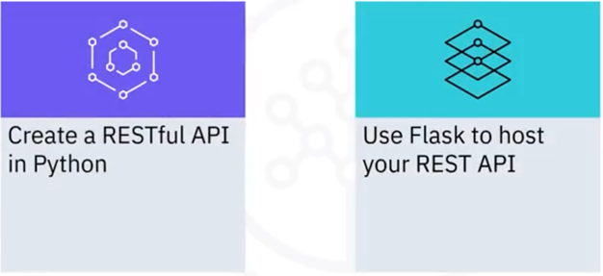
What you will learn

Slide 3
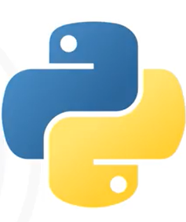
Python
• Programming language that
integrates your systems effectively
• Supports web development
• Used in scientific and numeric
computing
• Used in Al and machine learning

Slide 4

Flask
• Micro web framework
• Simple and scalable
• Lightweight applications
• Good choice for RESTful APIs

Slide 5
Prerequisites
• Python 3 (verify by running python -- version)
• Pip (verify by running pip-- version)
• Proceed to install Flask by running pip install flask

Slide 6
Recap
• Flask is a micro web framework to host Python web
applications
• You can create your first RESTful API as a microservice using
Python
• You can host your first RESTful API using Flask

